Slide 1

Virtual Campus Walk-through
Group No. 4
Mandar Kumbhar [17104017]
Rutvik Lathiya [17104050]
Sahil Naik [17104054]
Project Guide: Prof. Kaushiki Upadhyaya
Coguide: Prof. Nahid Shaikh

Slide 2
Contents
Introduction
Objectives
Problem Definition
Technological Stack
Review Suggestions
Phases of the Project
Prototype Design Demonstration
Plan of Paper Publication

Slide 3
Introduction
VR is able to immerse you in a Computer-Generated world of our own making. With VR, we can explore any Uncharted Territory of the Human Imagination.
Virtual Campus refers to accumulation centre that provides information which allows students to access the college campus online. Building a virtual campus acts as great tool towards providing insights to real environment as well as for improvised teaching.
This involves building a virtual tour for the students by combining all kinds of digital campus resources as well as integrating teaching, laboratory services management and other related activities.
Virtual campus tour is an effective tool to provide management planning, effective consumption of college resources.
We present a three dimensional model to the users of our system.

Slide 4
Objectives
To provide the advantage of virtual roaming .
Gives the users a professional feel and look.
Display correct information about that direction in which the user goes.
Provide a collaborative virtual reality environment for virtual tours alternative to traditional real Life tours for college campuses.

Slide 5
Problem Definition
To create a Virtual Reality application for the institute to introduce students newcomers to the institute with a Virtual Model of the college and make them familiar with the facilities available.
To provide a real life walk-through of the campus while being stationary with VR ready devices.

Slide 6
Proposed Technology Stack
Software Requirements:
Unity 3D
Blender :-
Texture Mapping- UV Mapping
Rendering Engine- Eevee and Cycles
Hardware Requirements:
VR Headset
VR Controllers

Slide 7
Review Suggestions
To add Proposed Technology Stack content in slide and report.
To define the texture mapping tools and rendering engine used in project.
To present a prototype or some implementation of project.

Slide 8
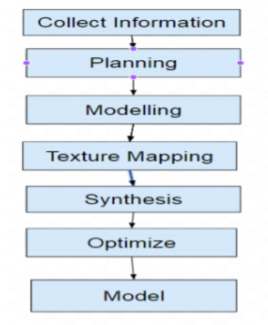
Phases of the Project

Slide 9
Phases of the Project
Collect Information: Firstly we are going to collect information about the whole campus which includes the information about the campus surroundings and also the information about the interior of the college premises for example the number of classrooms per floor ,the location of the canteen,library, staff room etc. and most importantly the outer structure of the college.
Planning: After gathering the information we will do planning based on the information collected and decide about how the tasks are going to performed sequentially in order to achieve the best possible outcome. Feasibility and budget of the project will also be decided and most importantly time management will be done accordingly.

Slide 10
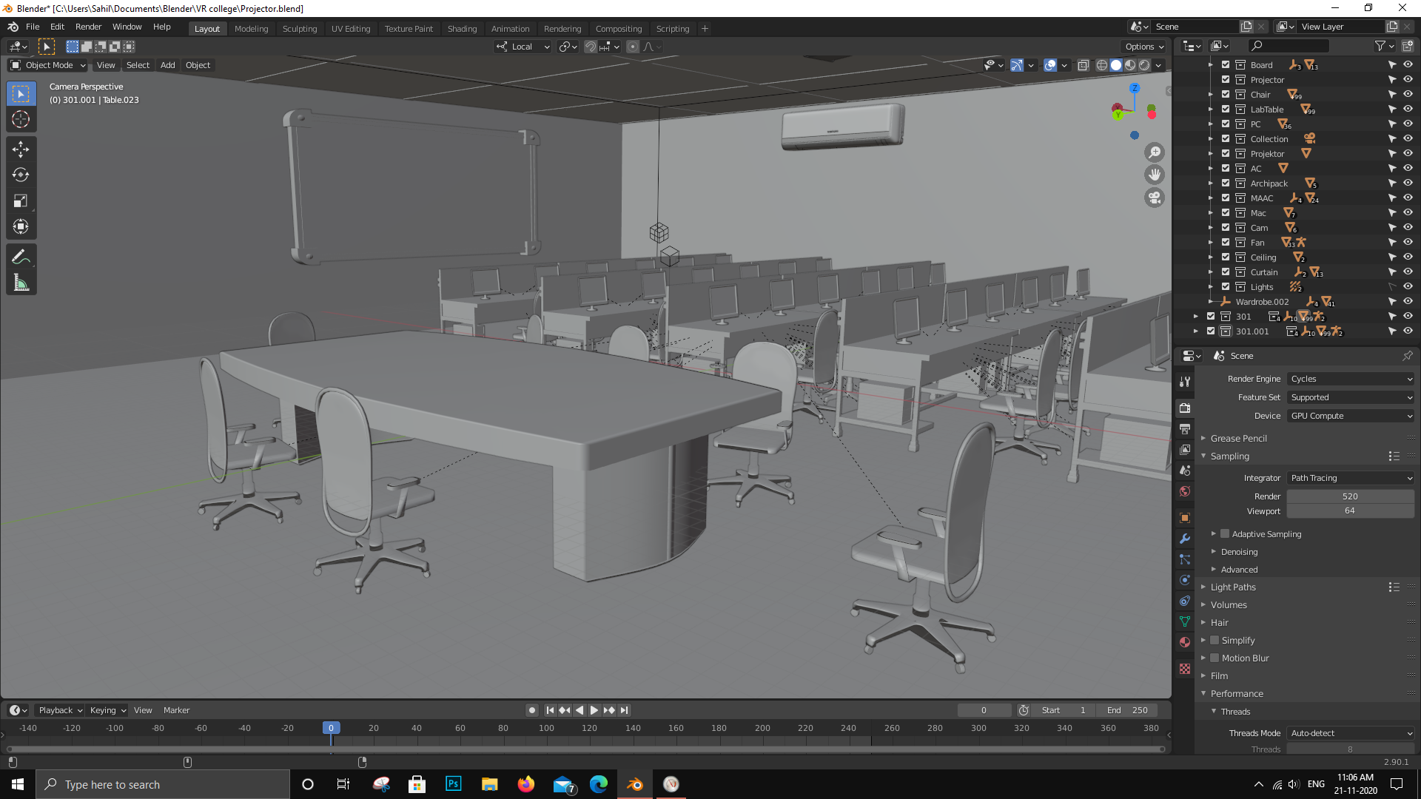
Phases of the Project
Modelling: Based on the information collected about the campus, modelling will be done of the gathered parameters so that the user could feel the environment while walking through the campus. For modelling purpose software tools like blender ,unity 3d and cinema 4d are going to be used.

Slide 11
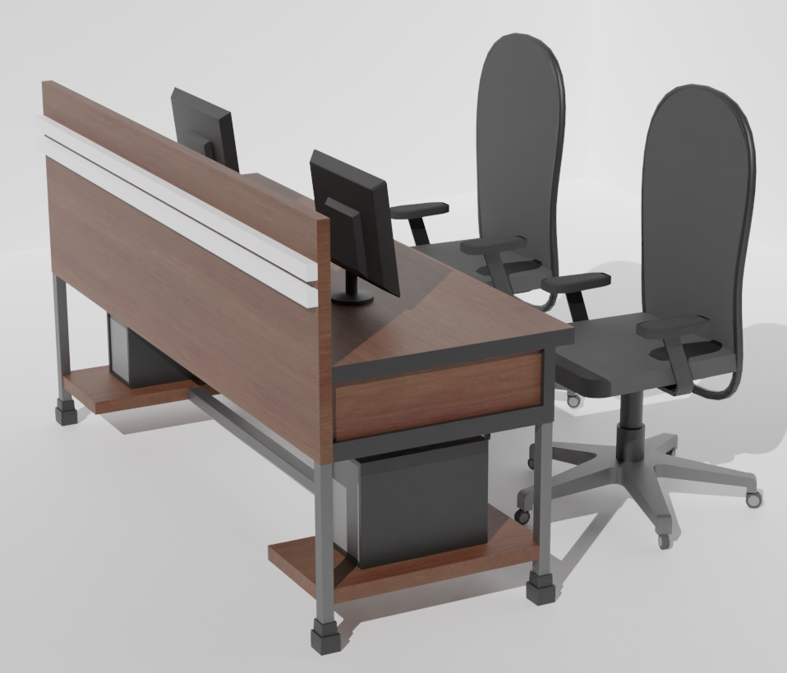
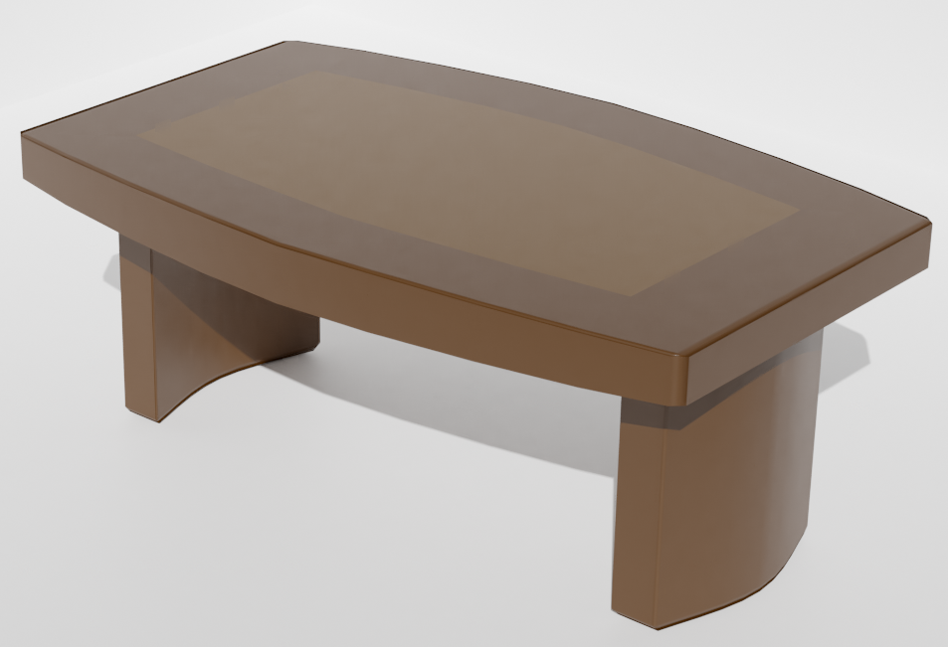
Phases of the Project
Texture Mapping: Texture mapping is a method for defining high frequency detail, surface texture, or colour information on a computer-generated graphic or 3D.model. So, whatever modelling we had done so far will go through texture mapping in order to provide a realistic view of the environment to the user.

Slide 12
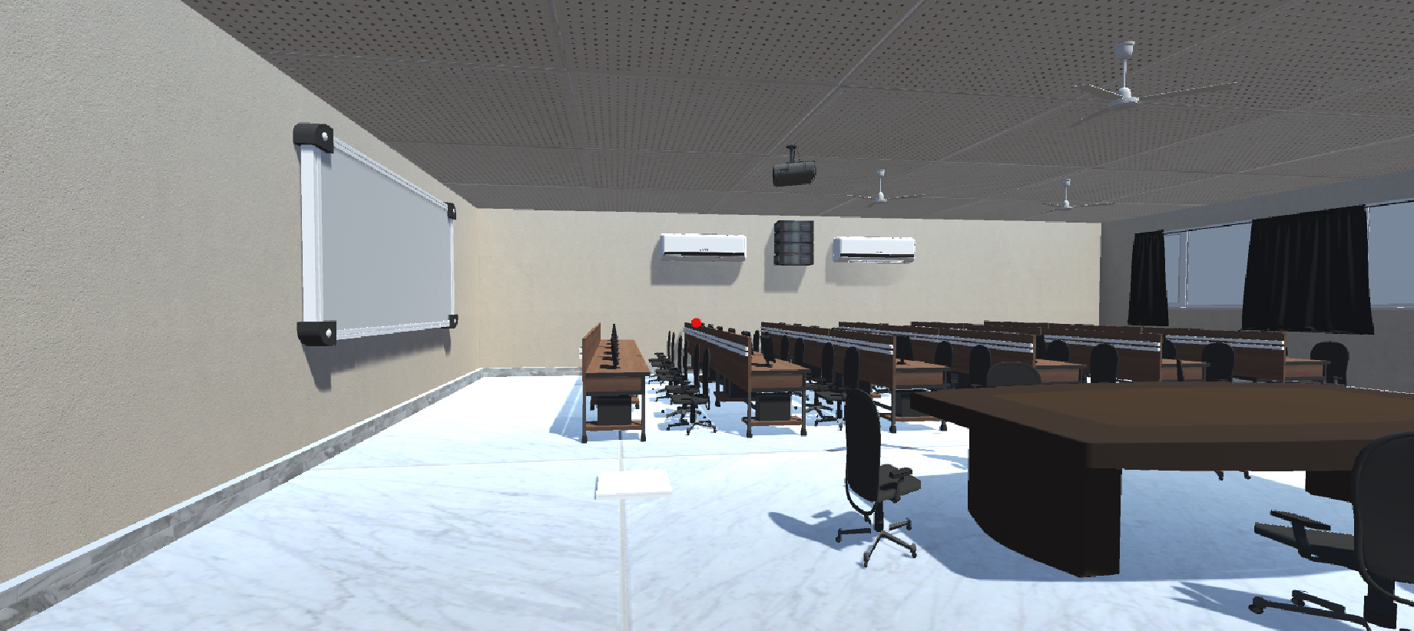
Phases of the Project
Synthesis: Synthesis means the combining of separate elements or substances to form a coherent whole. Therefore what all individual modelling that has been done will be combined together to build the project as a whole. This all will be done by using unity3d. All the object files will be imported in unity 3d and then will be combine.

Slide 13
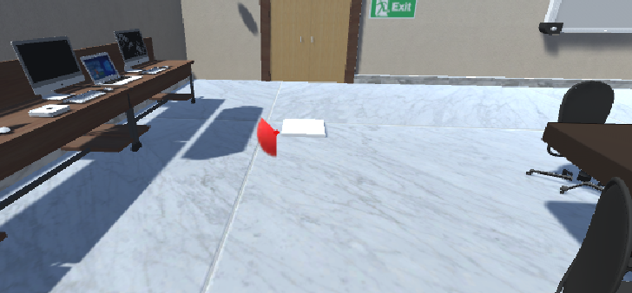
Phases of the Project
Optimize: Optimizing means increasing the efficiency and making the best and effective use. Optimization implies manage intentional change and continuous improvement. After the synthesis process is completed optimization process will begin.

Slide 14
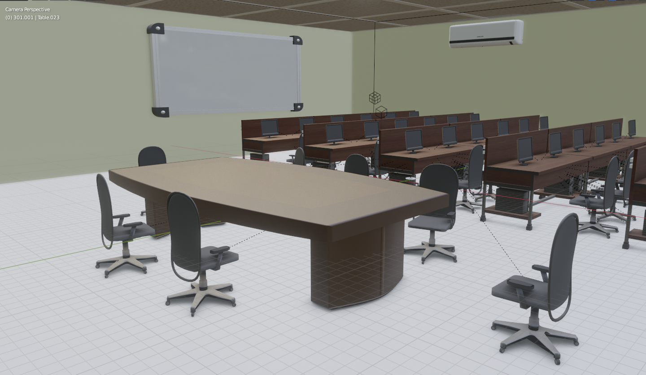
Phases of the Project
Model: Therefore after optimizing all the work that we have done, the final model will be saved and displayed to the user of the system which is nothing but a virtual campus. By using the keyboard the user can walk through the campus or the user can also have virtual reality view of the campus through google cardboard or also can use oculus instrument.

Slide 15
Prototype Design Demonstration
Scene of room 317

Slide 16
Prototype Design Demonstration
Implemented the teleporting tiles to teleport around the scene to provide a real life walk-through.

Slide 17
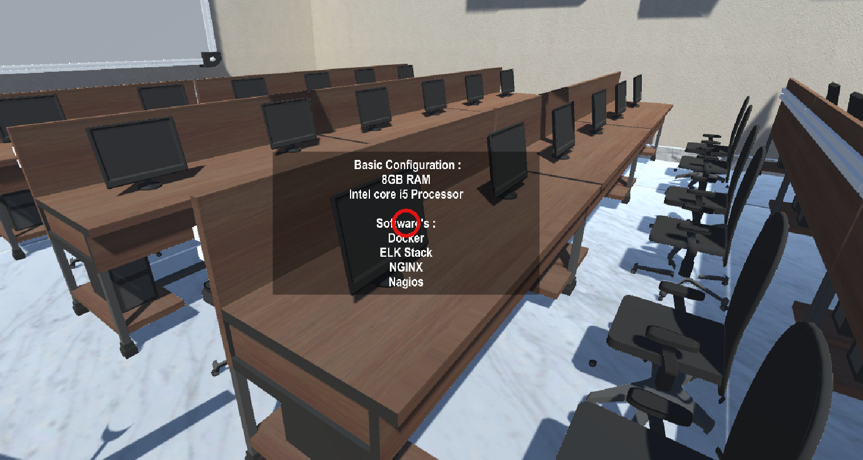
Prototype Design Demonstration
Implemented the information panel popping up on seeing on a specific object in a scene.

Slide 18
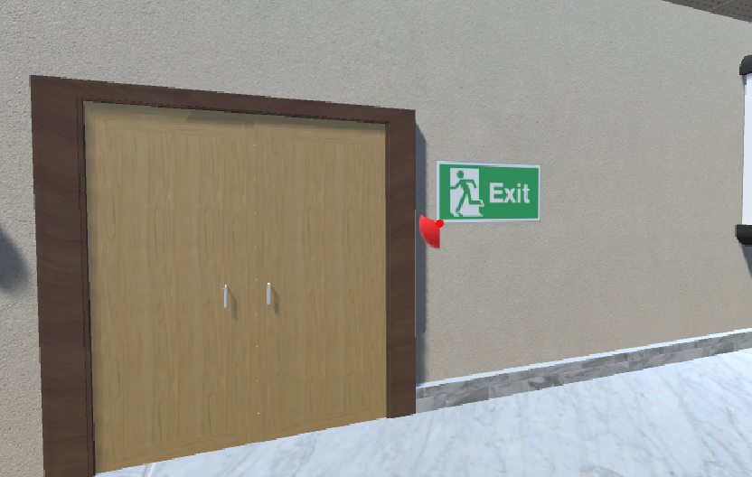
Prototype Design Demonstration
Implemented the entry and exit mechanism to enter and exit a room in scene.

Slide 19
Plan of Paper Publication
We are planning to present a paper in IEEE International Conference. We are done with the abstract, introduction and literature survey.

Slide 20
Thank You!

